Slide 1
XML
Introduction to XML
LEVEL – PRACTITIONER

Slide 2
About the Author
Created By: | Shanmu (105110)
Credential Information: | Sr Architect.
Version and Date: | 1.0, November 22’nd 2011
Cognizant Certified Official Curriculum
Notes:
For the animators:
This screen content needs to be rendered in the flash, no animations needed.

Slide 3
Session Objective
After completing this chapter you will be able to understand:
What is a XML file?
Difference between XML & HTML
What is DTD?
Create a Sample XML file

Slide 4


What is an XML
XML stands for Extensible Markup Language.
XML is used for describing data, holding data and transferring data between systems.
XML tags are to be defined by user.
XML is a W3C recommendation.
Employee.xml
<Employee>
<ID> 12345</ID>
<Name>Jack</Name>
</Employee>
XML describes employee Data
It holds Jack’s data.
It transfers the data to a remote server.
XML Transfer

Slide 5

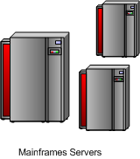
Advantages of XML
Interoperability:
Two different systems can interoperate by sending messages in the form of XML.
Employee.xml
<Employee>
<ID> 12345</ID>
<Name>Jack</Name>
</Employee>
XML Transfer
Mainframe and Java systems interoperating by sending messages in XML format.

Slide 6
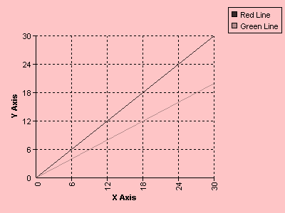

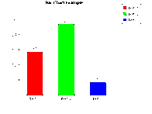
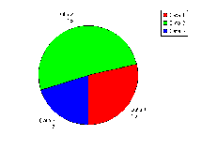
Advantages of XML
Multiple Representations:
XML can be represented in multiple formats using technologies like XSL.
View
Sales Data.xml
<Sales>
Sales data goes in here.
</Sales>
Line Chart
XML Transfer
Bar Chart
Sales data represented in multiple view formats, pie chart, bar graph & line chart.
Pie Chart

Slide 7
HTML Vs XML
HTML | XML
HTML represents data and presentation logic. Thus used for developing presentation layer. | XML represents data only and are used for sharing data.
HTML are developed to render views in a predefined format. Example: Table (or) Charts (or) Simple paragraph. | XML since it holds only data it can be dynamically rendered in any formats. Example: Pie Chart, Bar Chart etc.
HTML does not have a specific structure. | XML can be created with specific structure thus used for transferring data between systems.

Slide 8
Building blocks of XML document
The following are the elements of XML document,
Elements
Attributes
Entities
PCDATA
CDATA

Slide 9
XML Elements
Elements are the main building blocks of an XML document.
An XML document contains one or more elements.
Example: <EmployeeName></EmployeeName>
An element can contain
Text - <EmployeeName>Raja</EmployeeName>
Another element.
<Employee>
<EmployeeName>Raja </EmployeeName>
</Employee>
Empty - <EmployeeName></EmployeeName>

Slide 10
XML Elements
An XML document has a main element under which all the other elements are enclosed this is referred to as “Root” element.
<?xml version="1.0" encoding="ISO-8859-1"?>
<Earth>
<Continent>
<name>Asia</name>
<description>Asian continent</description>
<Countries>65</Countries>
</Continent>
<Continent>
<name>Africa</name>
<description>African continent</description>
<Countries>45</Countries>
</Continent>
</Earth>
Earth is the root element

Slide 11
XML Attributes
Attributes provide some extra information about an element.
Attributes always come in name-value pairs.

Slide 12
XML Attributes Example
Example:
<project projectNumber=“1”>
Credit Card System
</project>
Where:
“project” is an element
“projectNumber” is an attribute of “project” element
“1” is the value of “projectNumber” attribute
“Credit Card System” is the value of “project” element

Slide 13
XML Entities
Entities are characters that have special significance in XML document.
Example: “<“ & “>” This signifies the start & end of a XML tag.
<Employee> Jack</Employee>
If this characters are encountered in the value of the XML element the XML parser will throw an error.
Error Thrown: <Message>if age >20 </Message>
To avoid error: <Message>if age &gt; 20 </Message>

Slide 14
XML Entities
There are five entities,
&lt; stands for <
&gt; stands for >
&amp; stands for &
&quot; stands for “
&apos; stands for ‘
Additional entities can be defined in a DTD

Slide 15
PCDATA
PCDATA means Parsed Character Data.
XML Parsers when parsing the element also parses the PCDATA text inside the element
Example: <message>This text is also parsed</message>
So if a XML has a text,
<message>Age is < 100</message>
Assuming that text is declared as PCDATA the parser will throw and error when parsing the text “Age is < 100” as the character “<“ would be considered as XML start tag.
Correct Procedure: <message>Age is &lt; 100</message>

Slide 16
XML CDATA
CDATA means Character Data.
Any text that should not be parsed by the XML parser needs to declared as CDATA.
Example: <message>This text will not be parsed</message>
So if a XML has a text
<message> <![CDATA[Age is < 100 ]]> </message>
This will not throw an error as the text will not be parsed.

Slide 17

Time To Reflect
Associates to reflect the following topics before proceeding.
What is difference between XML & HTML?
What are the two major advantages of XML?
What are the building blocks of XML?
What is the difference between PCDATA and CDATA?
What are the XML entities?

Slide 18
Lend a Hand: XML explaining the building blocks
A shopping complex has a online portal where the customers can login and buy some products. When buying products the customer needs to send the following data in XML format to the shopping application.
List of Products
Each product should have the following data
Product Name
Product Description
Product Type (Grocery/Apparel/Electronics)
Attribute: Comments
Quantity
Associates should spend 15 minutes to create a XML for the specification provided.

Slide 19
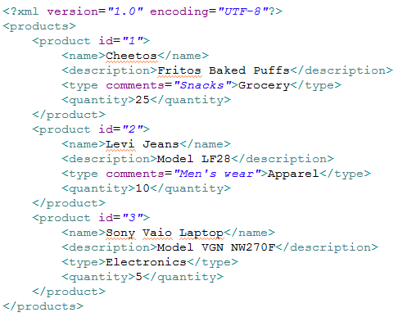
Lend a Hand: Solution
Solution:

Slide 20
What is DTD?
DTD stands for Document Type Definition, this is used for defining the structure and the list of elements of a XML file.
Employee.dtd
This DTD will define the structure and node definitions of the employee XML
Employee.xml
<Employee>
<ID> 12345</ID>
<Name>Jack</Name>
<Salary> 10000</Salary>
</Employee>
Employee Node
ID
Name
Salary

Slide 21
How to declare a DTD
There are two ways of declaring DTD
Internal reference : Declared inline inside a XML.
External Reference: Included as a reference pointing to a external file.
Internal Reference
External Reference
<DTD Implementation goes in Here>
<Employee>
<ID> 12345</ID>
<Name>Jack</Name>
<Salary> 10000</Salary>
</Employee>
<!DOCTYPE Library "http://abc.com/Employee.dtd">
<Employee>
<ID> 12345</ID>
<Name>Jack</Name>
<Salary> 10000</Salary>
</Employee>

Slide 22
Why do we need DTD?
DTD are used by parsers for validating the structure of the XML.
DTD are used as a contract between two systems to interoperate.
An application can use the DTD to validate the XML structure it has received from external systems.
Employee.xml
<Employee>
<ID> 12345</ID>
<Name>Jack</Name>
</Employee>
XML Transfer
The xml parsers in mainframe servers will use the “employee.dtd ” to verify the XML structure before consuming the data

Slide 23
Learning DTD using a sample XML
Lets take a sample XML
<Earth>
<Continent>
<name>Asia</name>
<description>Asian continent</description>
<Countries comment=“Number of countries” >65</Countries>
</Continent>
<Continent>
<name>Africa</name>
<description>African continent</description>
<Countries comment=“Number of countries” >45</Countries>
</Continent>
</Earth>

Slide 24
DTD Element Declaration
How Elements are declared?
<!ELEMENT element-name category>
(or)
<!ELEMENT element-name (element-content)> -- Elements with Child elements occurring once
Taking the XML example
<!ELEMENT Countries (#PCDATA)> -- This means that the countries element is a PCDATA element.
(OR)
<!ELEMENT Continent (Name,Description,Countries)> -- This means the continent element has three elements under it.

Slide 25
DTD Element Declaration
How to declare element with minimum one occurrence?
<!ELEMENT element-name (element-content+)>
Taking the XML example, assume that the continents can appear one or more times
<!ELEMENT Earth (Continent+)> -- This means that the element continent should be present at least once.

Slide 26
DTD Element Declaration
How to declare element with zero (or) one occurence?
<!ELEMENT element-name (element-content?)>
Taking the XML example, assume that the countries can appear zero (or) one
<!ELEMENT Continent (Countries?)> -- This means that the element countries can appear zero or one time under continent element.

Slide 27
DTD Element Declaration
How to declare element with zero (or) many occurence?
<!ELEMENT element-name (element-content*)>
Taking the XML example, assume that the countries can appear zero (or) many
<!ELEMENT Continent (Countries*)> -- This means that the countries element can appear zero or many times under continent element.

Slide 28
DTD Element Declaration
How to declare element with either/or content?
Taking the XML example, assume that Name (or) description can be present under the Continent tag.
<!ELEMENT Continent ((Name|Description),Countries)>
This means the continent element has two elements under it Countries and either of Name/Description should appear.

Slide 29
DTD Attribute Declaration
How to declare an attribute for an element?
<!ATTLIST element-name attribute-name attribute-type default-value>
Taking the XML example, assume that Country element has a attribute Comments.
<!ELEMENT Countries(#PCDATA)>
<!ATTLIST Countries Comments CDATA “Number Of Countries”>
This means the Countries element has a attribute “Comments” which is a character data with default value “Number of Countries”

Slide 30
DTD Attribute Declaration
The attribute default value can have three values
Default Value | Description
#REQUIRED | The attribute is mandatory
#IMPLIED | The attribute is not required
#FIXED <value> | This represents that the value of attribute can only be the specified value.

Slide 31
Complete DTD for the sample XML
NOTE: Text in brown color are either the elements (or) attributes.
The DTD for the sample XML looks like ,
<!DOCTYPE Earth[
<!ELEMENT Earth (Continent+)>
<!ELEMENT Continent (Name,Description,Countries)>
<!ELEMENT Name(#PCDATA)>
<!ELEMENT Description(#PCDATA)>
<!ELEMENT Countries(#PCDATA)>
<!ATTLIST Countries Comments CDATA #REQUIRED>
]>
DOCTYPE declares the root element (or) root node which is “Earth”.

Slide 32
Elements Vs Attributes
Data can be stored in either child elements or attributes.
There are no rules about when to apply attributes and when to apply child elements.
General guideline is to store data in child elements and avoid attributes.

Slide 33
Well Formed XML
A well-formed XML document should have correct XML syntax:
An XML document must have a root element
XML tags are case-sensitive
Every XML element must have a closing tag
XML elements must be properly nested
XML attributes must be enclosed in quotes

Slide 34
Valid XML
An XML document is said to be a “valid” document,
if it satisfies all the requirements of a well-formed document (and)
It also conforms to a DTD or an XML Schema.

Slide 35
Time To Reflect
Associates to reflect the following topics before proceeding.
What is a DTD?
Why do we need a DTD?
How do we declare a element
To occur zero or many times
To occur zero or one times
To occur one or more time
Either of an element to appear
What is a Well formed and a valid XML?

Slide 36
Lend a Hand: Create a DTD
For the shopping complex online application XML file create a DTD.
List of Products
Products can one or more products
Each product should have the following data
Product Name
Product Description – Either of Product name or description to be present.
Product Type (Grocery/Apparel/Electronics) – Should have an attribute “Comments” it is not mandatory. This element should appear zero or one time.
Quantity – should appear zero or many times.

Slide 37
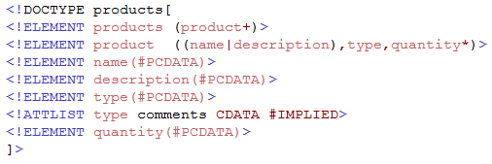
Lend a Hand: Solution
Solution:

Slide 38
XML
You have successfully completed -
Introduction to XML

